Slide 1
The Van Emde Roas Tree
Preliminary approaches, Recursive structure
By
Mr. Gururaj
Assistant Professor-Selection Grade
Department of Computer Science & Engineering
M.I.T Manipal

Slide 2
Preliminary approaches
Direct addressing:
To store a dynamic set of values from the universe {0,1,2,….. U-1}, we maintain an array A={0,1,2,….u-1} of u bits.
The entry A(x) holds a 1 if the value x is in the dynamic set, and it holds a 0 otherwise.

Slide 3
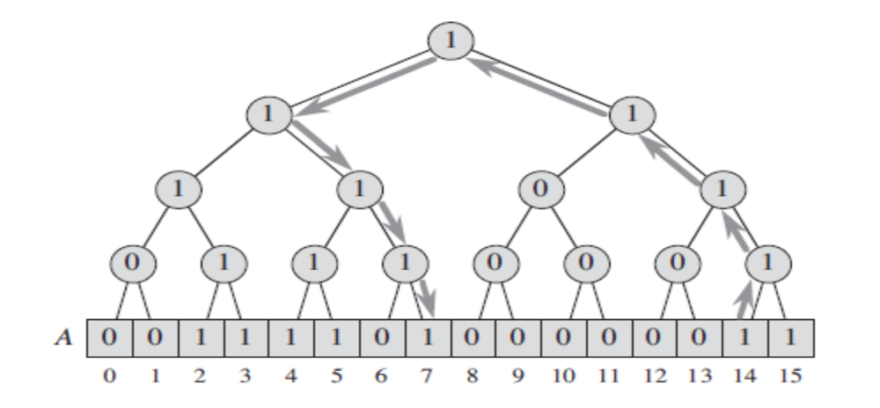
Preliminary approaches
A binary tree of bits superimposed on top of a bit vector representing the set
{2,3, 4, 5,7, 14,15} when u =16. Each internal node contains a 1 if and only if some leaf in
its subtree contains a 1. The arrows show the path followed to determine the predecessor of 14
in the set.

Slide 4

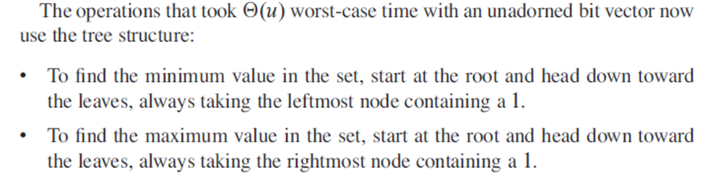
Preliminary approaches

Slide 5
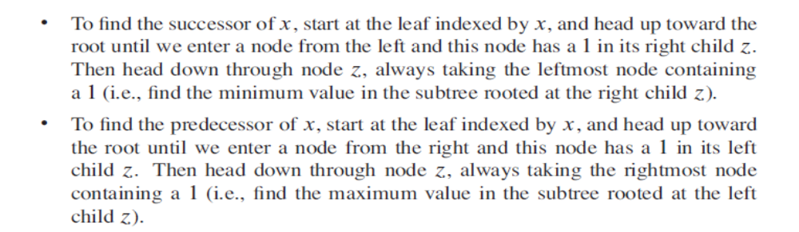
Preliminary approaches

Slide 6
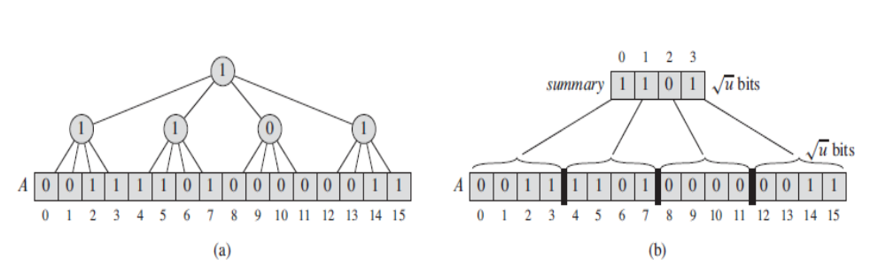
Preliminary approaches

Slide 7
A recursive structure
superimposing a tree of degree √u on top of a bit vector.
summary structure of size √u, with each entry pointing to another structure of size √ u.
shrinking the universe size by the square root at each level of recursion.
Starting with a universe of size u, we make structures holding √u= u^{1/2} items, which themselves hold structures of u^{1/4} items, which hold structures of u^{1/8} items, and so on, down to a base size of 2.

Slide 8
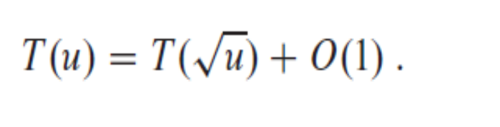
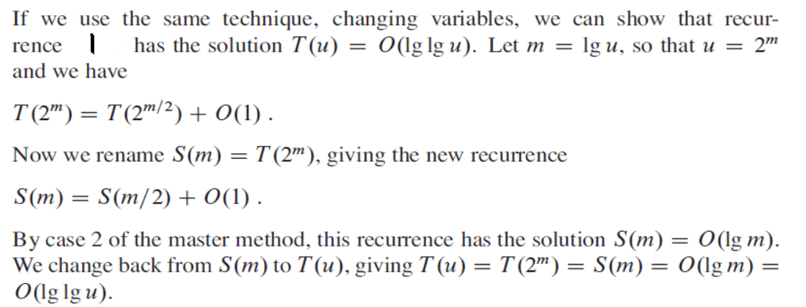
Analysis
Running Time for the operations
1

Slide 9
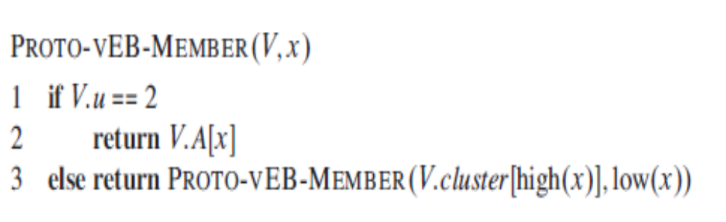
Proto-VEB Member function

Slide 10
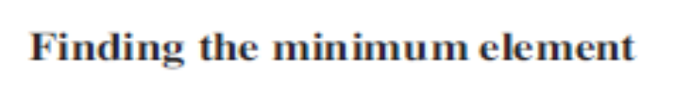
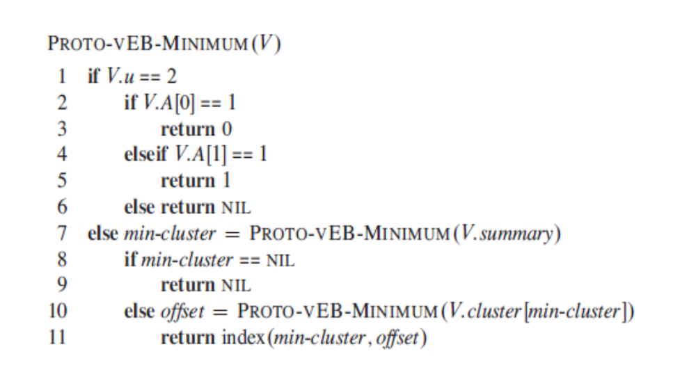

Slide 11
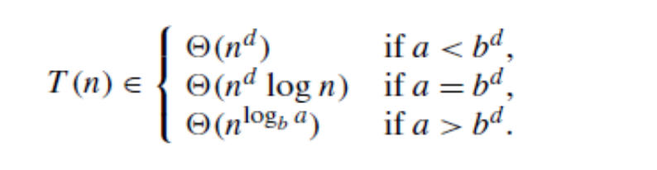

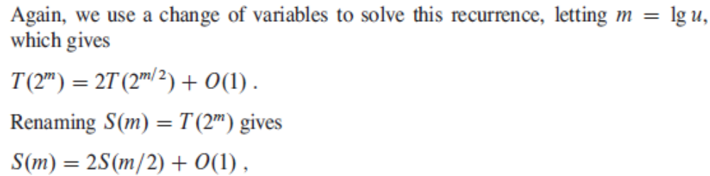
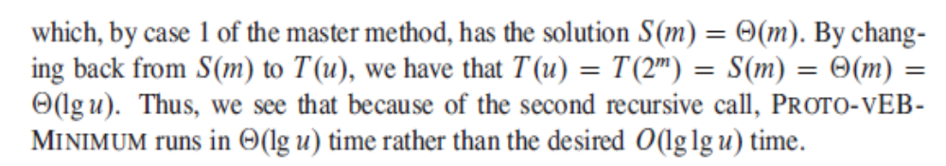
Proto-Veb Minimum

Slide 12
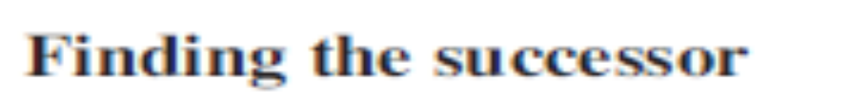
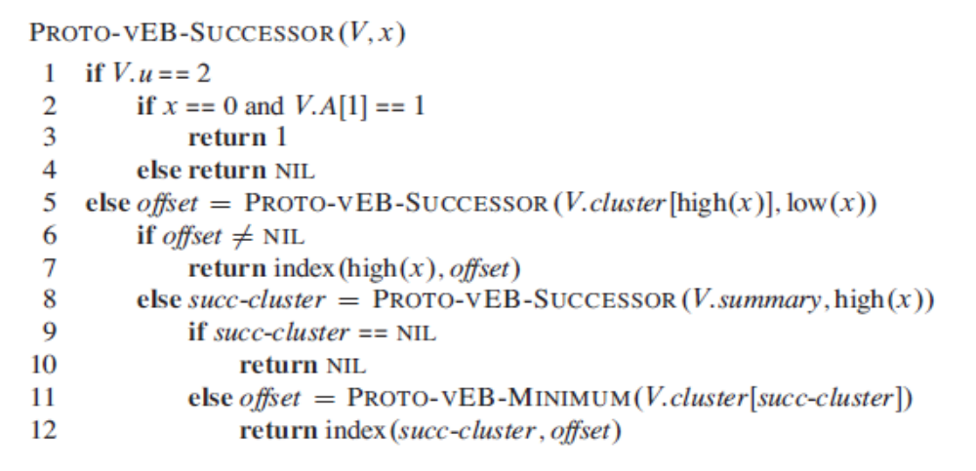

Slide 13
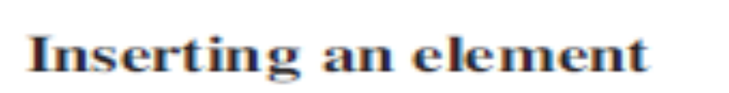
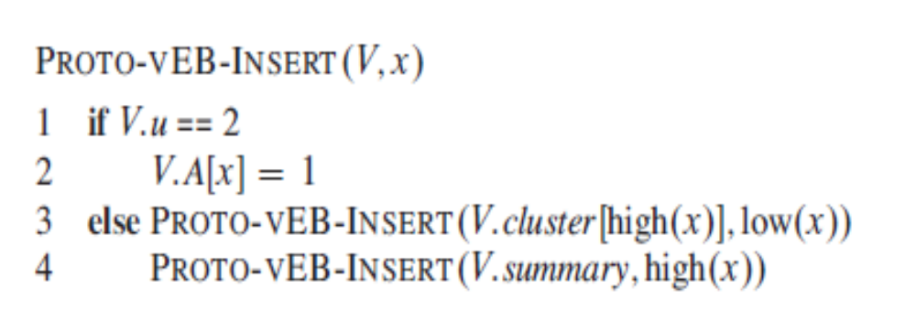

Slide 14
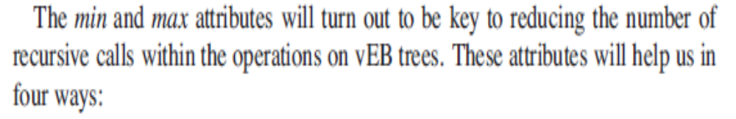
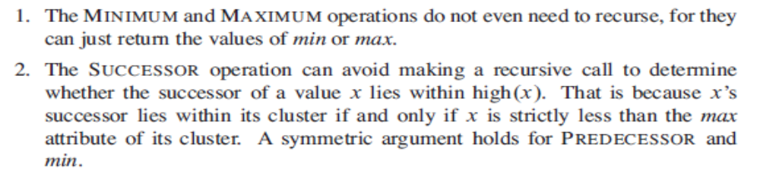

Slide 15
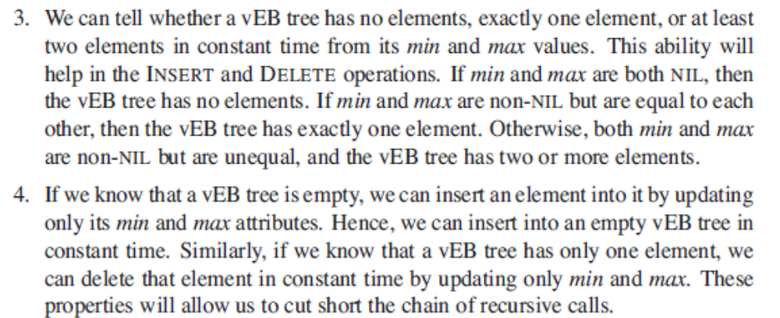

Slide 16
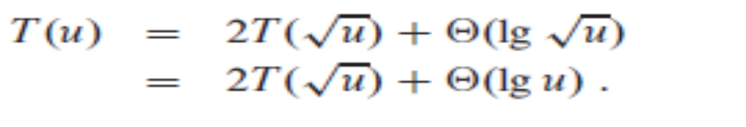
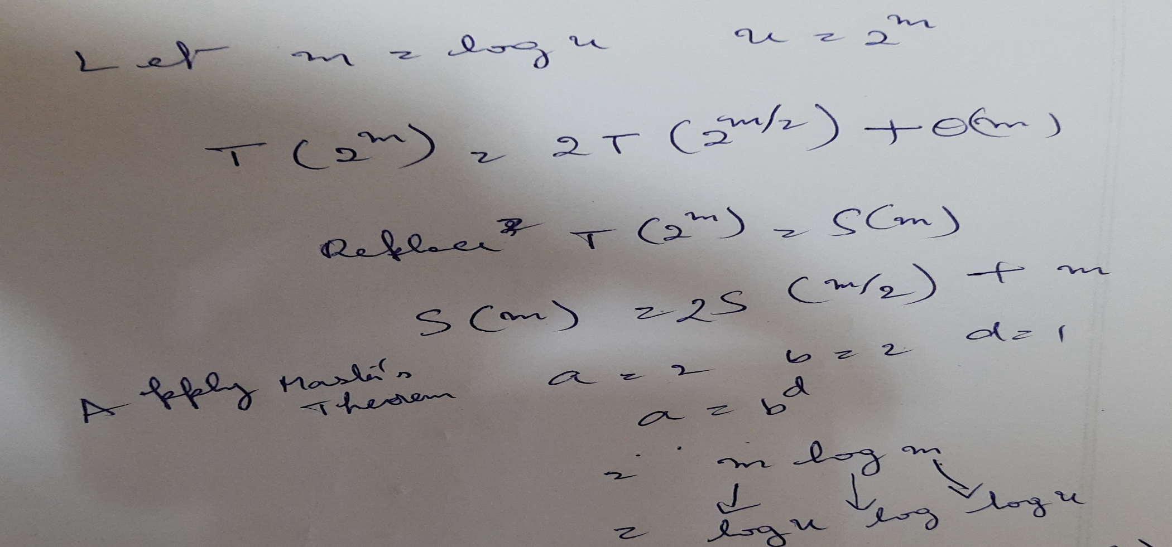
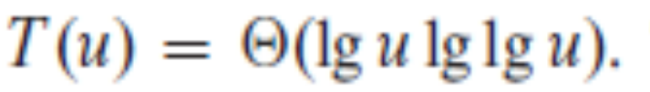
Worst case running time T(u) of proto-VEB successor

